Slide 1
The Pintos Instructional Operating System Kernel
Ben Pfaff
blp@nicira.com
Nicira Networks
Anthony Romano
ajromano@stanford.edu
Stanford University
Godmar Back
gback@cs.vt.edu
Virginia Tech

Slide 2
Overview
Tool paper
Series of 4 projects that provide backbone of lab component that accompanies OS course
Suitable for Junior/Senior/1st Grad students
Used by several institutions
Stanford (4 years+), Virginia Tech (3 years), University of San Francisco, William and Mary, University of Salzburg, Linköping Universitet, KAIST, Seoul National University, POSTECH

Slide 3
Teaching OS
Internal Perspective
Teaches how an OS works from the inside, specifically, the kernel
Places students in the perspective of OS designer, rather than OS user
Concrete Approach
Design and create realistic artifacts
Internalize abstractions by seeing concrete incarnation

Slide 4
Desiderata
Pintos Features
Small enough so entire code can be read and understood by students
Unlike Linux or Windows
Runs and debugs in simulated environment
100% reproducible, like single-threaded user code
Runs and debugs in emulated environment
facilitates non-intrusive analysis tools
Runs on real hardware
boots on student’s PC/laptop

Slide 5
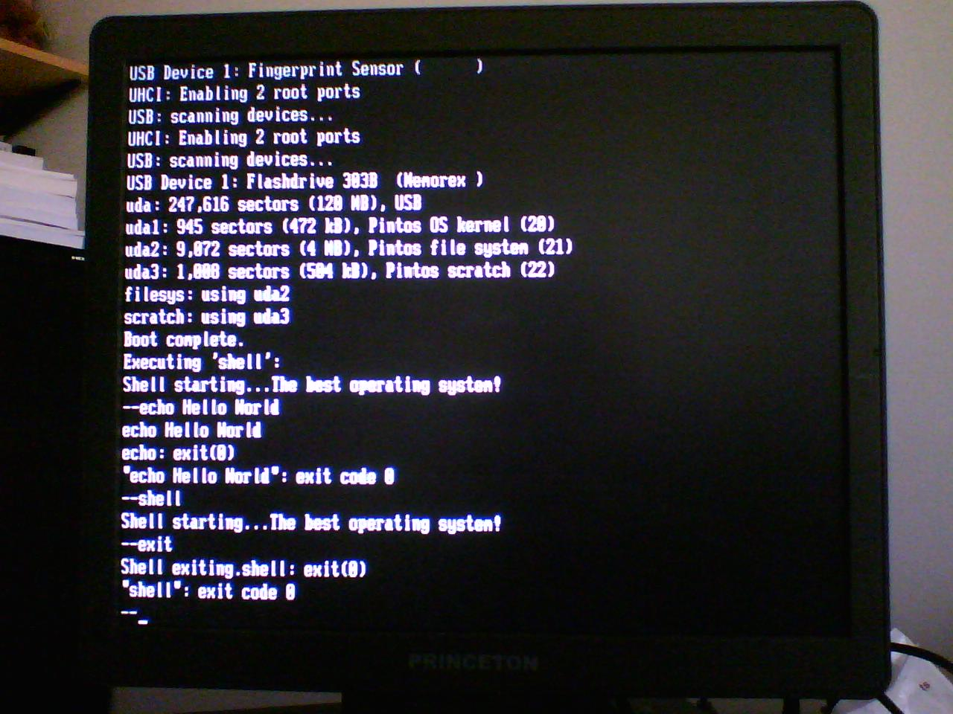

Slide 6
Project Principles (1)
Read Before You Code
Provide well-documented code that serves as example of what we expect from students
Between 0-600 lines per project
Notes:
Split slide to better support narrative

Slide 7
Project Principles (2)
Maximize Creative Freedom
Specify requirements
Don’t prescribe solution approaches
Notes:
Split slide to better support narrative

Slide 8
Project Principles (3)
Practice Test-driven Development
All tests are public, reading tests makes requirements concrete
Student can add their own tests
Project | Functionality | Robustness | Regression
1 | 27
2 | 41 | 35
3 | 20 | 14 | 75
4 | 39 | 7 | 75
Notes:
Split slide to better support narrative

Slide 9
Project Principles (4)
Justify Your Design
Provide structured questionnaires that students use to describe and justify their design rationale
Notes:
Split slide to better support narrative

Slide 10
Project Principles (5)
Work In Teams
2-4 students
Allows for brainstorming and mutual support
Mimics industrial setting, e.g., use of shared source code repository and versioning
Design questionnaires still submitted individually
Notes:
Split slide to better support narrative

Slide 11
Pintos Project Themes
Threads
User Programs
Virtual Memory
File Systems

Slide 12
Pintos Kernel
P1: Kernel-mode Test Cases
Priority Scheduling
Alarm Clock
MLFQS Scheduling
Threading
Simple Scheduler
Device Support
Keyboard, VGA, USB, Serial Port, Timer, PCI, IDE
Boot Support
Support Code
Public Tests
Pre Project 1

Slide 13
Pintos Kernel
P1: Kernel-mode Test Cases
Priority Scheduling
Alarm Clock
MLFQS Scheduling
P1: Alarm Clock
P1: Priority Inheritance
P1: MLFQS
P1: Priority Scheduler
Threading
Simple Scheduler
Device Support
Keyboard, VGA, USB, Serial Port, Timer, PCI, IDE
Boot Support
Support Code
Students Create
Public Tests
Post Project 1

Slide 14
Example of Project 1 Test
void
test_priority_change (void)
{
msg ("Creating a high-priority thread 2.");
thread_create ("thread 2", PRI_DEFAULT + 1, changing_thread, NULL);
msg ("Thread 2 should have just lowered its priority.");
thread_set_priority (PRI_DEFAULT - 2);
msg ("Thread 2 should have just exited.");
}
static void
changing_thread (void *aux UNUSED)
{
msg ("Thread 2 now lowering priority.");
thread_set_priority (PRI_DEFAULT - 1);
msg ("Thread 2 exiting.");
}
Expected output:
Creating a high-priority thread 2.
Thread 2 now lowering priority.
Thread 2 should have just lowered its priority.
Thread 2 exiting.
Thread 2 should have just exited.

Slide 15
make grade (1)
TOTAL TESTING SCORE: 100.0%
ALL TESTED PASSED -- PERFECT SCORE
- - - - - - - - - - - - - - - - - - - - - - - - - - - - - - - - - - - - - -
SUMMARY BY TEST SET
Test Set Pts Max % Ttl % Max
--------------------------------------------- --- --- ------ ------
tests/threads/Rubric.alarm 18/ 18 20.0%/ 20.0%
tests/threads/Rubric.priority 38/ 38 40.0%/ 40.0%
tests/threads/Rubric.mlfqs 37/ 37 40.0%/ 40.0%
--------------------------------------------- --- --- ------ ------
Total 100.0%/100.0%
- - - - - - - - - - - - - - - - - - - - - - - - - - - - - - - - - - - - - -
Pintos include fully automated grading scripts, students see score before submission

Slide 16
make grade (2)
SUMMARY OF INDIVIDUAL TESTS
Functionality and robustness of alarm clock (tests/threads/Rubric.alarm):
4/ 4 tests/threads/alarm-single
4/ 4 tests/threads/alarm-multiple
4/ 4 tests/threads/alarm-simultaneous
4/ 4 tests/threads/alarm-priority
1/ 1 tests/threads/alarm-zero
1/ 1 tests/threads/alarm-negative
- Section summary.
6/ 6 tests passed
18/ 18 points subtotal
Functionality of priority scheduler (tests/threads/Rubric.priority):
3/ 3 tests/threads/priority-change
3/ 3 tests/threads/priority-preempt

Slide 17
Usermode Test Cases
Stress Tests
P2-4: System Call Functionality
P2-4: Robustness
P2-4: Basic Filesystem
Pintos Kernel
P1: Kernel-mode Test Cases
Priority Scheduling
Alarm Clock
MLFQS Scheduling
P1: Alarm Clock
P1: Priority Inheritance
P1: MLFQS
Basic Filesystem
P1: Priority Scheduler
Threading
Simple Scheduler
Device Support
Keyboard, VGA, USB, Serial Port, Timer, PCI, IDE
Boot Support
Support Code
Students Create
Public Tests
Pre Project 2

Slide 18
Usermode Test Cases
Stress Tests
P2-4: System Call Functionality
P2-4: Robustness
P2-4: Basic Filesystem
Pintos Kernel
P1: Kernel-mode Test Cases
P2: System Call Layer: Copy-in/out, FD Management
Priority Scheduling
Alarm Clock
MLFQS Scheduling
P2: Process Management
P1: Alarm Clock
P1: Priority Inheritance
P1: MLFQS
Basic Filesystem
P1: Priority Scheduler
Threading
Simple Scheduler
Device Support
Keyboard, VGA, USB, Serial Port, Timer, PCI, IDE
Boot Support
Support Code
Students Create
Public Tests
Post Project 2

Slide 19
Project 2 Functionality Test
/* This program echoes its command-line arguments */
int
main (int argc, char *argv[])
{
int i;
msg ("begin");
msg ("argc = %d", argc);
for (i = 0; i <= argc; i++)
if (argv[i] != NULL)
msg ("argv[%d] = '%s'", i, argv[i]);
else
msg ("argv[%d] = null", i);
msg ("end");
return 0;
}
Expected output for ‘args 1 2’
begin
argc=3
argv[0] = ‘args’
argv[1] = ‘1’
argv[2] = ‘2’
argv[3] = null
end

Slide 20
Project 2 Robustness Test
/* This program attempts to read memory at an address that is not mapped.
This should terminate the process with a -1 exit code. */
#include "tests/lib.h"
#include "tests/main.h"
void
test_main (void)
{
msg ("Congratulations - you have successfully dereferenced NULL: %d",
*(int *)NULL);
fail ("should have exited with -1");
}
Expected output:
bad-read: exit(-1)

Slide 21
Usermode Test Cases
Stress Tests
P2-4: System Call Functionality
P2-4: Robustness
P2-4: Basic Filesystem
P3: Virtual Memory
Pintos Kernel
P1: Kernel-mode Test Cases
P2: System Call Layer: Copy-in/out, FD Management
Priority Scheduling
Alarm Clock
MLFQS Scheduling
P2: Process Management
P1: Alarm Clock
P1: Priority Inheritance
P1: MLFQS
MMU Support
Physical Memory Manager
Basic Filesystem
P1: Priority Scheduler
Threading
Simple Scheduler
Device Support
Keyboard, VGA, USB, Serial Port, Timer, PCI, IDE
Boot Support
Support Code
Students Create
Public Tests
Pre Project 3

Slide 22
Usermode Test Cases
Stress Tests
P2-4: System Call Functionality
P2-4: Robustness
P2-4: Basic Filesystem
P3: Virtual Memory
Pintos Kernel
P1: Kernel-mode Test Cases
P2: System Call Layer: Copy-in/out, FD Management
Priority Scheduling
Alarm Clock
MLFQS Scheduling
P2: Process Management
P3: Memory-mapped Files
P1: Alarm Clock
P1: Priority Inheritance
P3: Address Space Manager
P3: Page Fault Handling
P1: MLFQS
P3: Page Replacement
MMU Support
Physical Memory Manager
Basic Filesystem
P1: Priority Scheduler
Threading
Simple Scheduler
Device Support
Keyboard, VGA, USB, Serial Port, Timer, PCI, IDE
Boot Support
Support Code
Students Create
Public Tests
Post Project 3

Slide 23
Usermode Test Cases
Stress Tests
P2-4: System Call Functionality
P2-4: Robustness
P2-4: Basic Filesystem
P3: Virtual Memory
P4: Extended Filesystem
Pintos Kernel
P1: Kernel-mode Test Cases
P2: System Call Layer: Copy-in/out, FD Management
Priority Scheduling
Alarm Clock
MLFQS Scheduling
P2: Process Management
P3: Memory-mapped Files
P1: Alarm Clock
P1: Priority Inheritance
P3: Address Space Manager
P3: Page Fault Handling
P1: MLFQS
P3: Page Replacement
MMU Support
Physical Memory Manager
Basic Filesystem
P1: Priority Scheduler
Threading
Simple Scheduler
Device Support
Keyboard, VGA, USB, Serial Port, Timer, PCI, IDE
Boot Support
Support Code
Students Create
Public Tests
Pre Project 4

Slide 24
Usermode Test Cases
Stress Tests
P2-4: System Call Functionality
P2-4: Robustness
P2-4: Basic Filesystem
P3: Virtual Memory
P4: Extended Filesystem
Pintos Kernel
P1: Kernel-mode Test Cases
P2: System Call Layer: Copy-in/out, FD Management
Priority Scheduling
Alarm Clock
MLFQS Scheduling
P2: Process Management
P3: Memory-mapped Files
P1: Alarm Clock
P1: Priority Inheritance
P3: Address Space Manager
P4: Hierarchical Multi-threaded Filesystem
and
Buffer Cache
P3: Page Fault Handling
P1: MLFQS
P3: Page Replacement
MMU Support
Physical Memory Manager
Basic Filesystem
P1: Priority Scheduler
Threading
Simple Scheduler
Device Support
Keyboard, VGA, USB, Serial Port, Timer, PCI, IDE
Boot Support
Support Code
Students Create
Public Tests
Post Project 4

Slide 25
Program Analysis
Development Machine (Linux)
Test Hardware
Standard PC with USB
Pintos Apps
Pintos Apps
Pintos Apps
Pintos Kernel
Pintos Kernel
Pintos Kernel
Simulation via Bochs
Emulation via Qemu
Program Analysis
Serial Port
Debugger
Compiler/
Toolchain
Grading
Scripts
Terminal Emulator

Slide 26
Race Detection Example
*** Race #1 ***
- Fault Point -
IP: c002da7d
Function: list_begin
Memory address at which race occurred: c003afc4
Memory base of object in which race occurred: c003afc0
This race affects global variable: open_inodes
Lockset:
- Threads involved in race -
* Backtrace (thread #1) *
list_remove (c002d565)(lib/kernel/list.c:260)
inode_close (c0032c1f)(filesys/inode.c:177)
file_close (c0032224)(filesys/file.c:52)
syscall_handler (c003175c)(userprog/syscall.c:288)
intr_handler (c0021f47)(threads/interrupt.c:377)
??? (c0022107)(../../threads/intr-stubs.S:38)
* Lockset (thread #1) *
In this example, students forgot to protect the list of open inodes, which is accessed concurrently by an exiting process (left backtrace) trying to close its files and a starting process (right backtrace) trying to open and read its executable
* Backtrace (thread #2) *
list_begin (c002da7d)(lib/kernel/list.c:74)
inode_open (c0032c83)(filesys/inode.c:118)
dir_open_root (c00327c0)(filesys/directory.c:57)
filesys_open (c0031b27)(filesys/filesys.c:69)
start_process (c002f7fb)(userprog/process.c:358)
kernel_thread (c002170f)(threads/thread.c:538)
* Lockset (thread #2) *

Slide 27
Evaluation (Fall 2008)
How confident are you in your ability to understand the output of the race condition checker?
Not at all confident, the output was very confusing. (2/44)
I sort of understood what it was trying to tell me, but my understanding was vague. (17/44)
After careful analysis of the output, I understood the causes leading to the displayed race and was able to fix it. (16/44)
Once I learned the general format of the output, I quickly found the underlying race condition that was flagged. (4/44)
No answer (5/44)
Based on survey given during final exam
In addition, more than 50% of students reported that the race condition checker helped them find actual bugs that made them pass project tests!
Notes:
Add chart!

Slide 28
Setting Up Pintos
Requires simple Linux server
1 quad core machine can support 8-10 students easily
All work can be done using remote ssh access, or an IDE can be used
No root user access required
Uses mostly host tools (gcc, binutils) and packages (bochs, qemu)
Includes texinfo manual (HTML, 129-page PDF)
Documentation separates generic and institution-specific parts in separate files, e.g.
Stanford: @set coursenumber CS140
Virginia Tech: @set coursenumber CS 3204

Slide 29
Placement in Curriculum
Cannot be a first course in C
Should probably be 4th or 5th programming course
Can be a first or second course in OS
Pintos projects can stretch over 10-15 weeks
Satisfies a “deep design” requirement

Slide 30
Related Work
Systems that provide internal kernel perspective
Simulated architecture only:
Nachos, ToyOS, OS/161, Yalnix
Emulated:
GeekOS, JOS
Real hardware:
GeekOS, Xinu, PortOS, JOS, Minix, Windows CRK, adapted versions of Linux

Slide 31
Future Work
Educational:
Introduce modular assignment structure to allow instructor to tailor assignments with reduced or varied scope
Integrate assessment tools
Integrate static analysis tools
Integrate performance measures
Technological:
Introduce multi-core/multi-processor support

Slide 32
Thank You!
Ben Pfaff
Anthony Romano
Godmar Back
Many Instructors, TA’s, and students who have contributed with tests and suggestions
URL: www.pintos-os.org
Mailing list: pintos-os@googlegroups.com

Slide 33
Usermode Test Cases
Stress Tests
P2-4: System Call Functionality
P2-4: Robustness
P2-4: Basic Filesystem
P3: Virtual Memory
P4: Extended Filesystem
Pintos Kernel
P1: Kernel-mode Test Cases
P2: System Call Layer: Copy-in/out, FD Management
Priority Scheduling
Alarm Clock
MLFQS Scheduling
P2: Process Management
P3: Memory-mapped Files
P1: Alarm Clock
P1: Priority Inheritance
P3: Address Space Manager
P4: Hierarchical Multi-threaded Filesystem
P3: Page Fault Handling
P1: MLFQS
P3: Page Replacement
MMU Support
Physical Memory Manager
Basic Filesystem
P1: Priority Scheduler
Threading
Simple Scheduler
Device Support
Keyboard, VGA, USB, Serial Port, Timer, PCI, IDE
Boot Support
Support Code
Students Create
Public Tests
Post Project 1

